Slide 1




Student Document Management & Cyber Security
Admission & ID records
Marksheets & certificates
Fee & scholarship files
Protecting student records from leaks, loss and forgery
Health & personal data
Presented by Sivapriya
Notes:
Student document management: admission, academic, financial and personal records. Presented by Sivapriya.

Slide 2
The problem: records at risk
PROBLEM STATEMENT
8,195
251
Student records (marksheets, IDs, fee and health data) sit in paper files, email, WhatsApp and shared drives. Without encryption, access control or tamper-proofing, they can be leaked, lost or forged, and the law now holds institutions liable.
weekly cyberattacks per education organisation in India vs 3,355 global average
ransomware attacks on schools and universities worldwide in 2025; 3.96M records exposed
₹22 cr
₹250 cr
Scattered copies, no single source of truth
Shared logins, no record of who changed what
No way to prove a certificate is genuine
average cost of a data breach in India (2025); phishing is the top entry route
maximum DPDP penalty for failing to keep reasonable security safeguards
Sources: Check Point Research via tele.net (Sep 2024); Comparitech via Cybersecurity Dive (Feb 2026); IBM Cost of a Data Breach 2025 (India); PIB, DPDP Rules 2025 (notified 14 Nov 2025)
Notes:
Attack rate: Check Point Research, reported Sep 2024 (education India 8,195 per week per organisation vs 3,355 global). Ransomware: Comparitech 2025 roundup (251 attacks, 94 confirmed, 3.96M records). Breach cost: IBM 2025, INR 220 million average in India, phishing 18% of initial vectors. DPDP Rules notified 14 Nov 2025 with 18-month phase-in; up to Rs 250 crore for failing to maintain reasonable security safeguards.

Slide 3
Our solution: a secure vault
A. STORING A DOCUMENT
1. Sign in with password + OTP
2. Validate file type and size
3. Encrypt (AES-256) and hash (SHA-256)
4. Save in encrypted vault
B. ACCESSING A DOCUMENT
5. Student or staff requests a file
6. Role check: is access allowed?
7. Decrypt and re-check the hash
8. Deliver the file
Mismatch: block + alert
Every step above is written to a tamper-evident audit log reviewed by the registrar
Notes:
Flow A covers storage: multi-factor sign-in, file validation, encryption plus a SHA-256 fingerprint, then storage. Flow B covers access: role check, decrypt and re-verify the fingerprint, deliver or block and alert. All actions are logged.

Slide 4
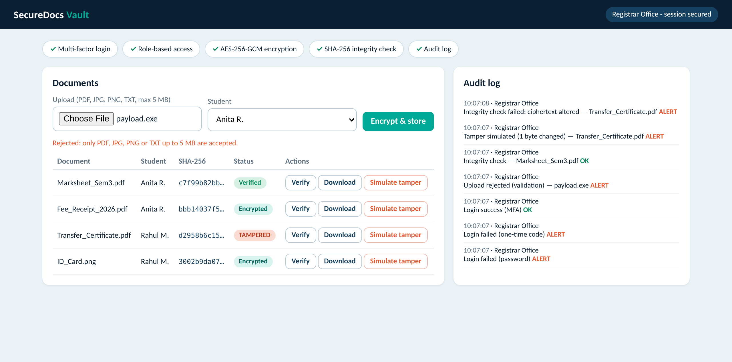
Prototype: SecureDocs Vault
Password + one-time code login; failed attempts are logged
Files encrypted with AES-256-GCM and fingerprinted with SHA-256
A one-byte change is caught as TAMPERED; all actions are audited
Working web prototype (securedocs_vault.html), runs in any modern browser
Notes:
Prototype built with HTML and the browser's Web Crypto API. Demonstrated: multi-factor login, role-based views, input validation, AES-256-GCM encryption, SHA-256 integrity verification, tamper detection and an audit log.

